Slide 1
NURC Northern Urology Research Collaborative
The possibilities and potential

Slide 2
What is a ‘Research Collaborative’?
A collaboration between specialty registrars in a region (deanery) with a desire for good quality, co-ordinated, multi-centre research and audits.
Currently a ‘hot topic’ and supported at a national level.

Slide 3
Why?
Difficult to conduct research alone
Natural network
Registrars rotating
Potential for multicentre trials
A multitude of benefits

Slide 4
Project
Methodology
& design
Data
Collection
& analysis
Team leading
& working
Patients
Write papers
Enhance CV
Trainee
Publications
& Presentations
Benefits of
Research
Collaborative
Multicentre
Trials
Transferable
skills
Quality of
Research
Region
More clinical
surgical trials
Better
recruitment

Slide 5
Other specialties…..
General Surgery (WMRC) – multiple others
National cardiothoracic research collaborative
Yorkshire Orthopaedic Trainees group
Radiologists (Midlands)
Plastic surgeons (London)
Ophthalmic surgeons (Newcastle)
Neurosurgeons (Oxford)
Dermatologists (Wales)

Slide 6
The potential....
Well illustrated by ‘WMRC’ (>100 trainees. 17 centres)
Rossini (Reduction of Surgical Site infection using a Novel Intervention) RCT
£232,000 NIHR funding
Fastest recruiting gen surg trial last year- closed
21 centres around UK.
Likely LANCET publication
Portfolio also includes;
2 other RCT’s in process
Multiple cohort studies and audits (500 – 8000 pts)

Slide 7
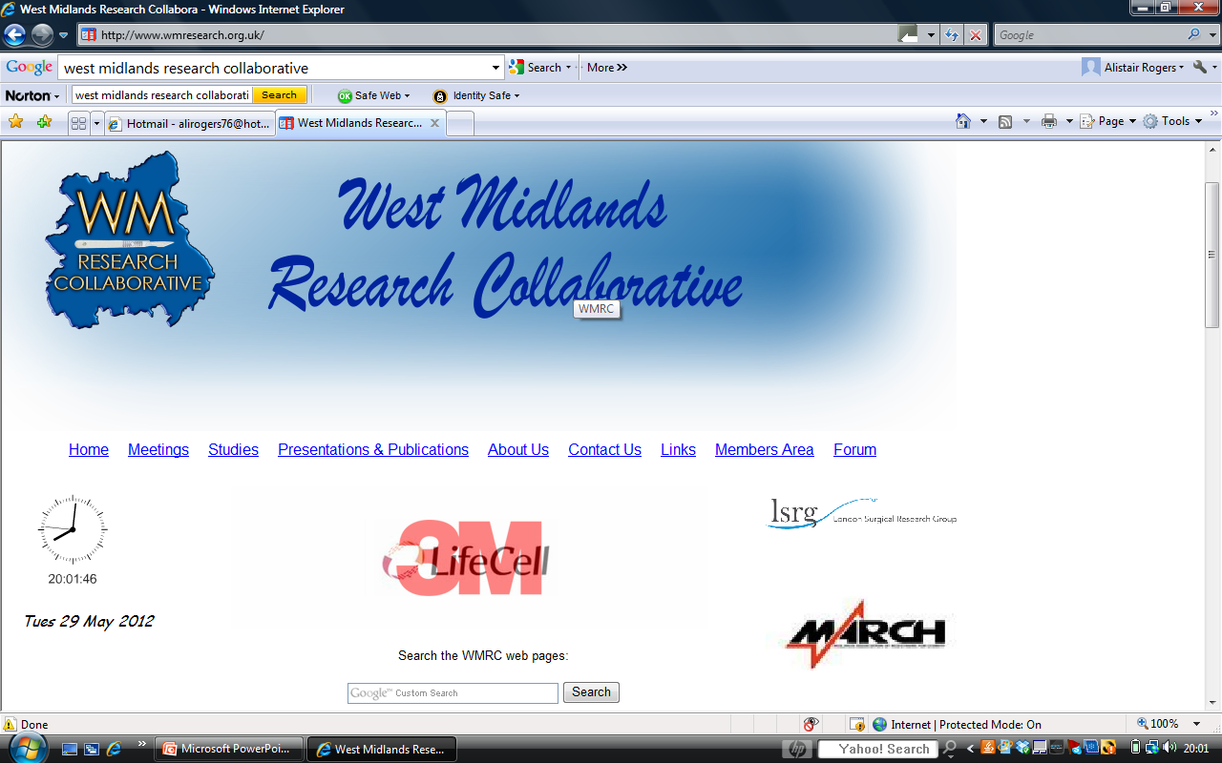

Slide 8
How they work it...
Once a month meetings. Educational as well as organisational.
Committee required if a lot involved – otherwise all help needed.
All grant applications/trial protocols etc written by SpR’s.
Web site. National and local funding.
Mobilisation of ‘junior docs’ (SHO/F1) in data collection/recruitment.
Inter-collaborative working nationally
Having a ‘collaborative project’ on the go is almost necessary for the ARCP now for them

Slide 9
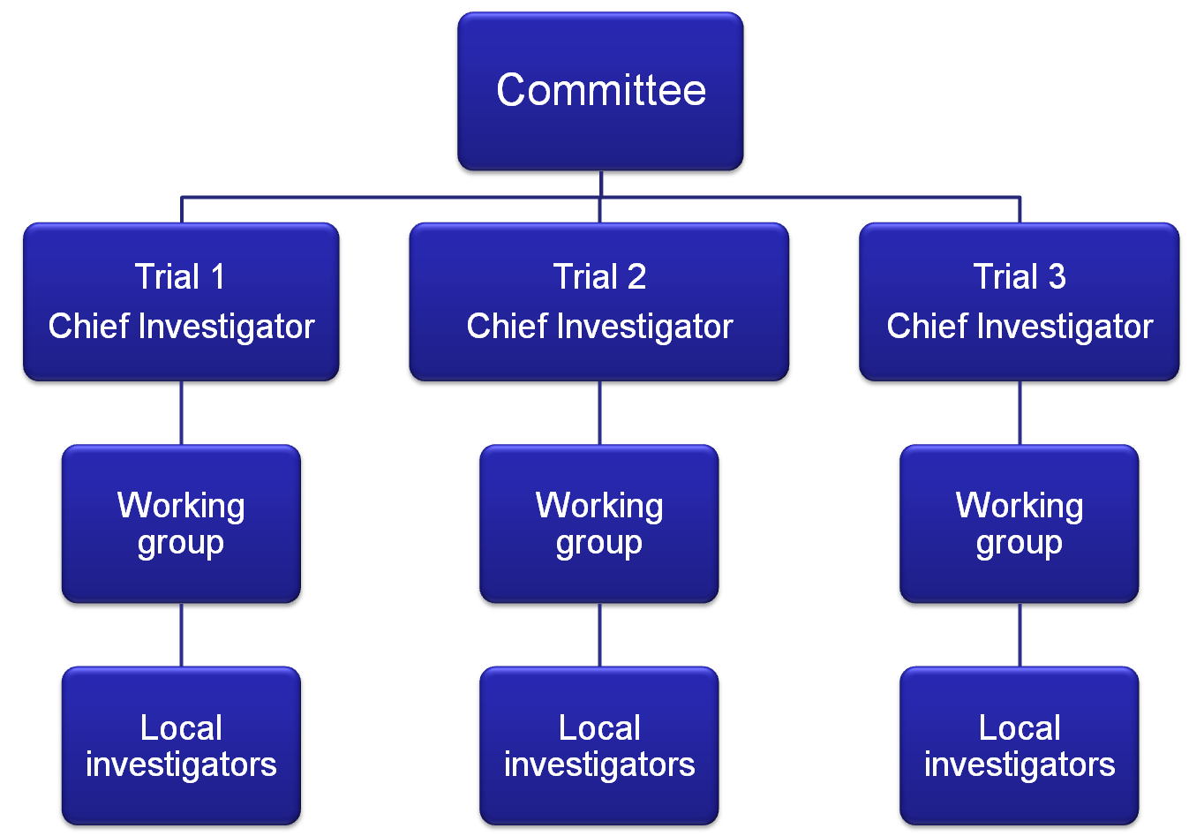
If it got big…….

Slide 10
Set up - potential problems
Getting us ‘on board’ – ownership and time
Decision on ‘what projects’ to do – need for a Godfather
How many people for each project
Formation of ‘authorship’ policy
Engagement of consultants and STC
Rotation of posts - The benefit is also the disadvantage

Slide 11
Authorship
Different ways of working this which we would need to decide.
One way;
The working group for a study will be the ‘writing group’ with the principle investigator first author. Others who have recruited the most/done large amounts of data collection can be co-opted onto writing group. All others who have done work will be ‘accredited’ via ‘on behalf of the NURC’ (they are citable papers) – therefore incentivises SHO’s etc.

Slide 12
Where are we at?....
We need to decide if this is going to worth the effort;
Discuss amongst ourselves
Support from Prof Pickard
Support from Chair of WMRC
It has happened before and is almost happening now.....
If there is a feeling of YES then....
Next steps?;
1) Set time and date for first meeting – mid July. Likely mid week in the evening in Urol Seminar Room at FRH.
2) Detailed agenda will go out beforehand
3) Invite submissions for research ideas which will be discussed – Prof will have a large say in what we should tackle first

Slide 13
Research Ideas
50 word abstract sent to Ali Rogers
1. Original
2. Aim answer to a simple question
3. Potential for high numbers eligible participants
(think TRUS, flexi, ED, prophylactic abx, not renal trauma)
4. Recruit/collect data for 12 months if prospective
5. Short lag time between entry and exit points from study i.e. max 6 months; 28 day infection rate = good; 5 year disease free survival = bad/too long
6. If RCT then patient and clinician in equipoise with regards to intervention. Situations involving pieces of novel technology that offer incremental advantage but cost money seem like good idea.
7. Can recruit at all 4 sites
8. Does not have to be clinical per se, could be about training itself
You don’t have to sell these at the meeting (and we may not get to discuss them at the first meeting) and ANY ideas are worthwhile

Slide 14
Once we get momentum...
Regular meetings as a whole group – how often?
Formation of a management committee/dividing up the jobs (depends on numbers of SpR’s involved)
The jobs include: Chairperson, Secretary, Webmaster, junior surgical liaison, Treasurer, New study manager, Chief Investigator of each study
Get support from local trials unit (could manage employment of study nurse etc.), CRN & national bodies
Communication
Develop web site
Forums
Links with NEUS etc.

Slide 15
The future?
To think big we need to start small;
Get one project completed, to time, written up, presented and submitted in a co-ordinated way (with type A surgical personalities!).
Once feasibility is shown, then progress. If we don’t you will not be hearing from me or NURC again…..
In the long run:
Co-ordination between other Urology Research Collaboratives; only NURC and North West at present.
BAUS
National high volume RCT’s – why not? There are not many trainees who will apply for consultant posts with that experience/CV – its too late for me but it is an amazing opportunity for the group if we are prepared to put the work in .........

Slide 16
Is the future bright for collaborative working?....
....I think so and SpR’s can be integral to this and we should maximise our potential.

Slide 17
Any Questions?

